Slide 1
Getting Started with Data Science and LLMs for Modern SEO
Elias Dabbas
October 28, 2025
Tokyo

Slide 2
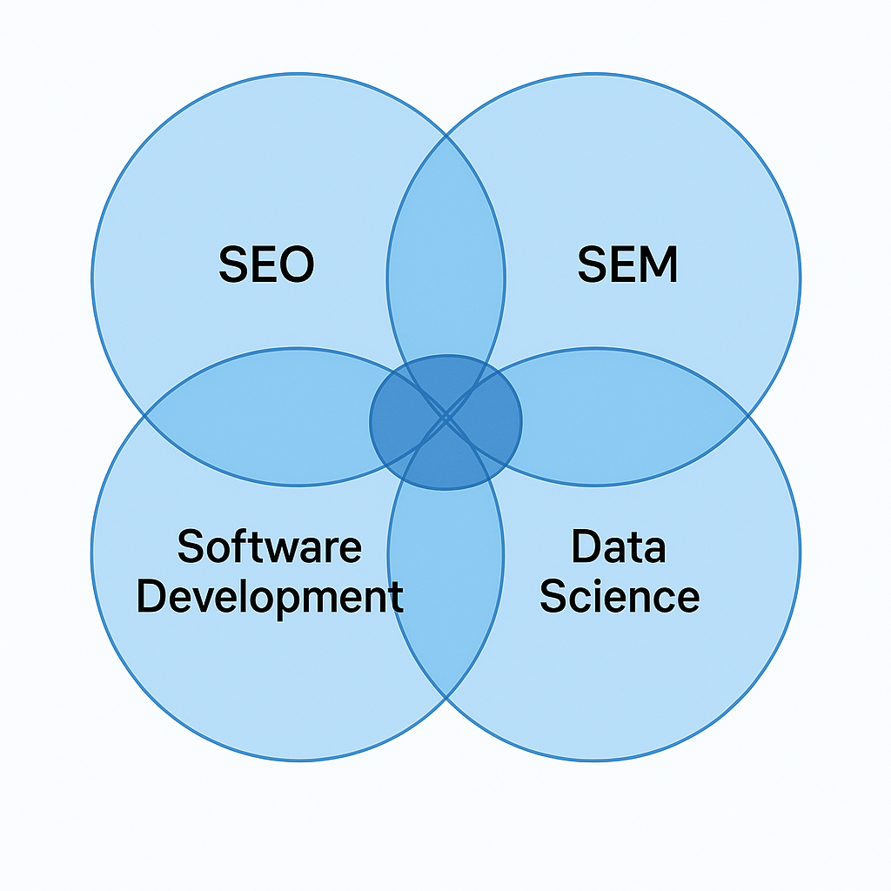
Me

Slide 3
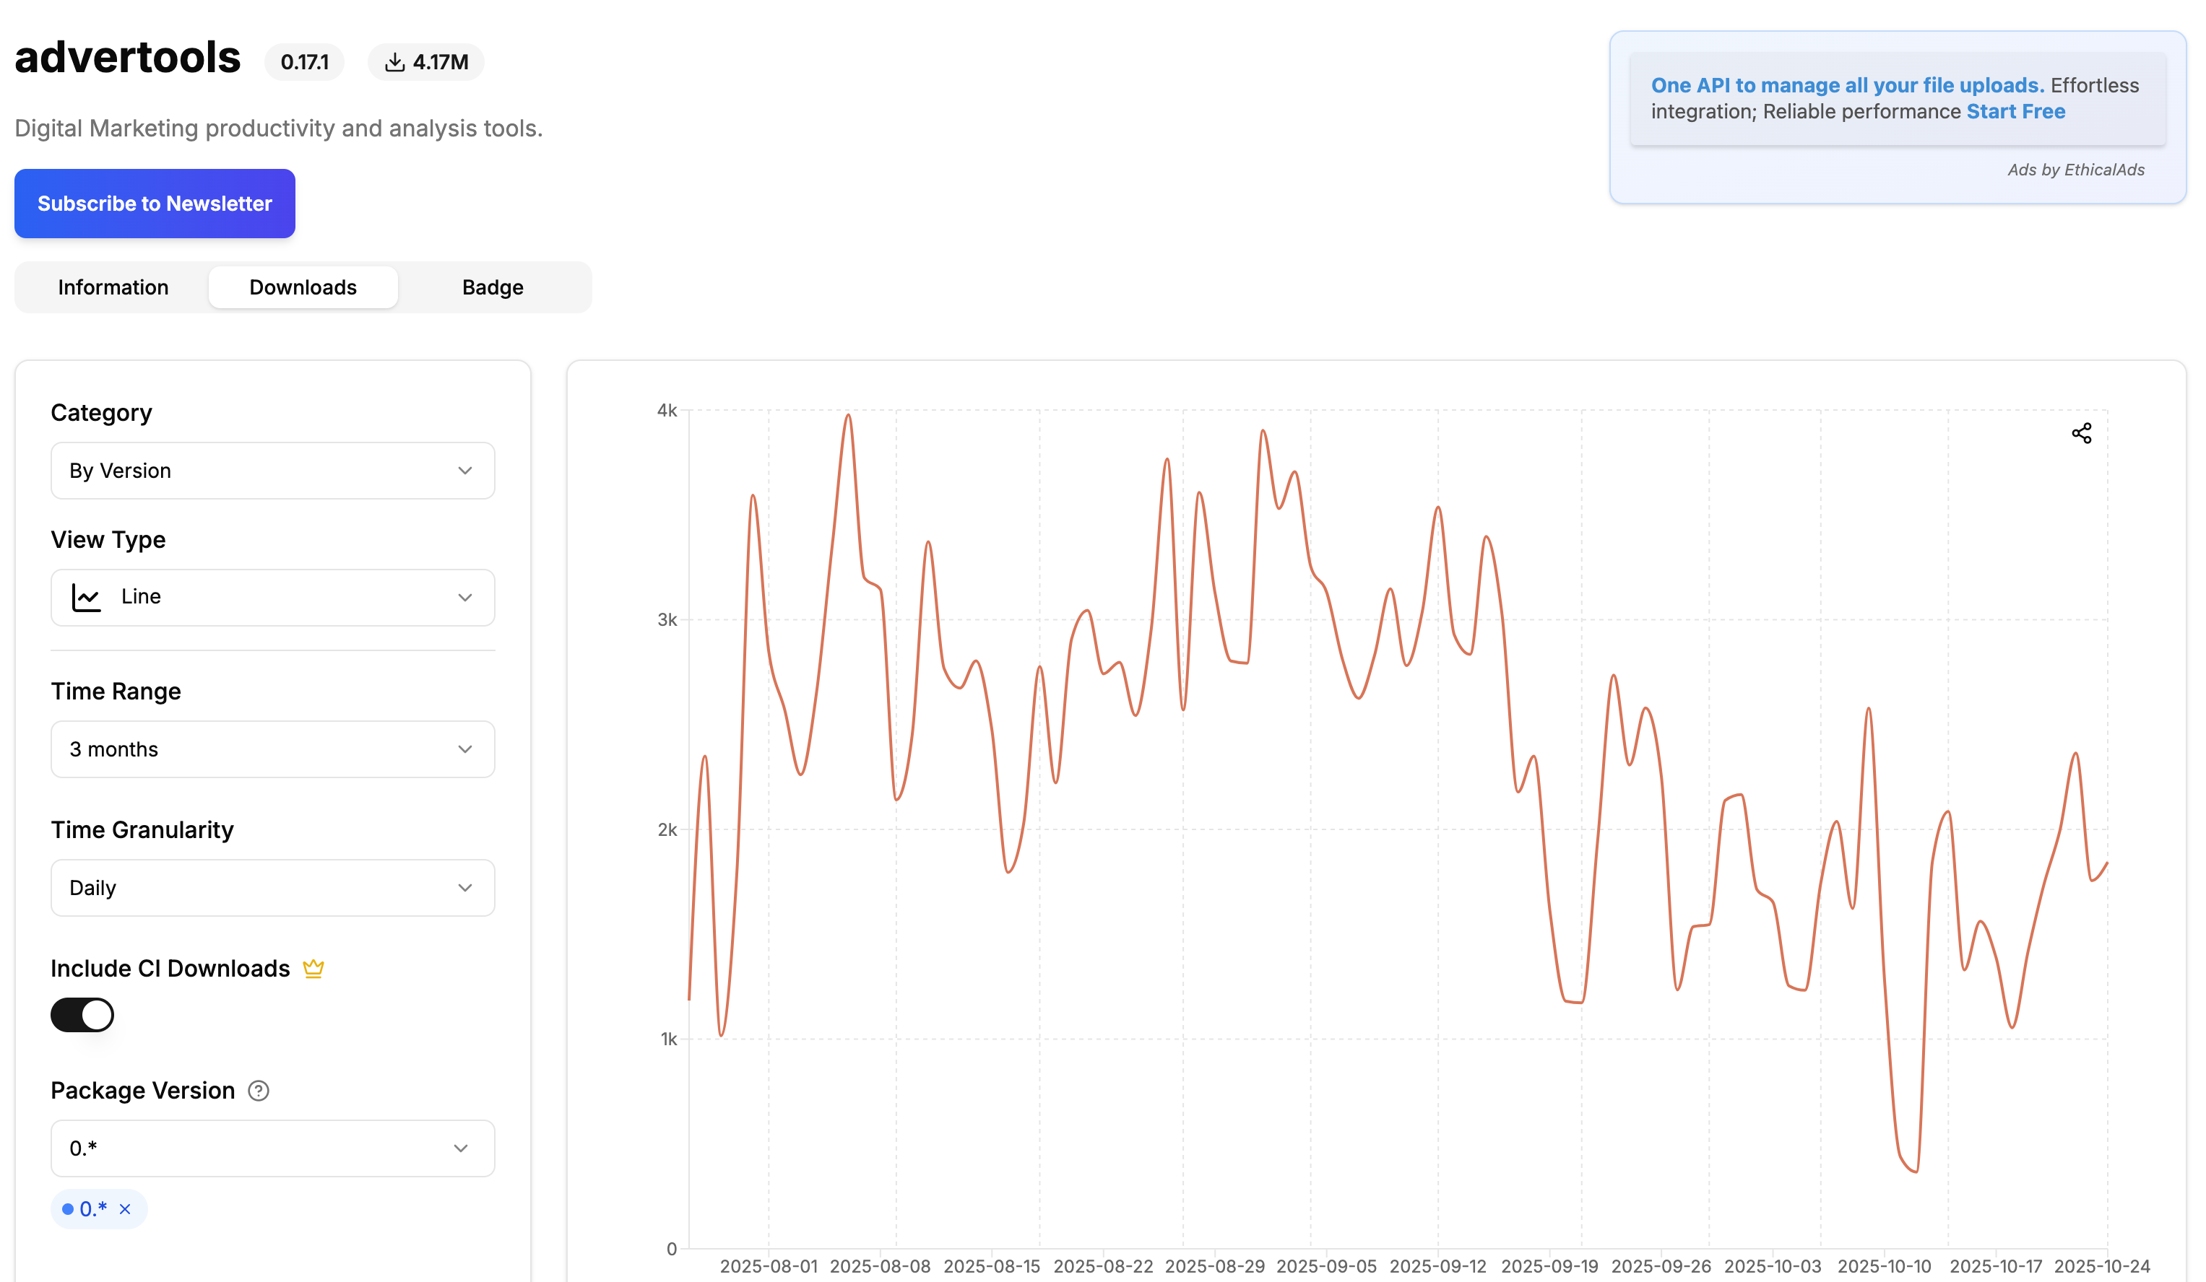

Slide 4
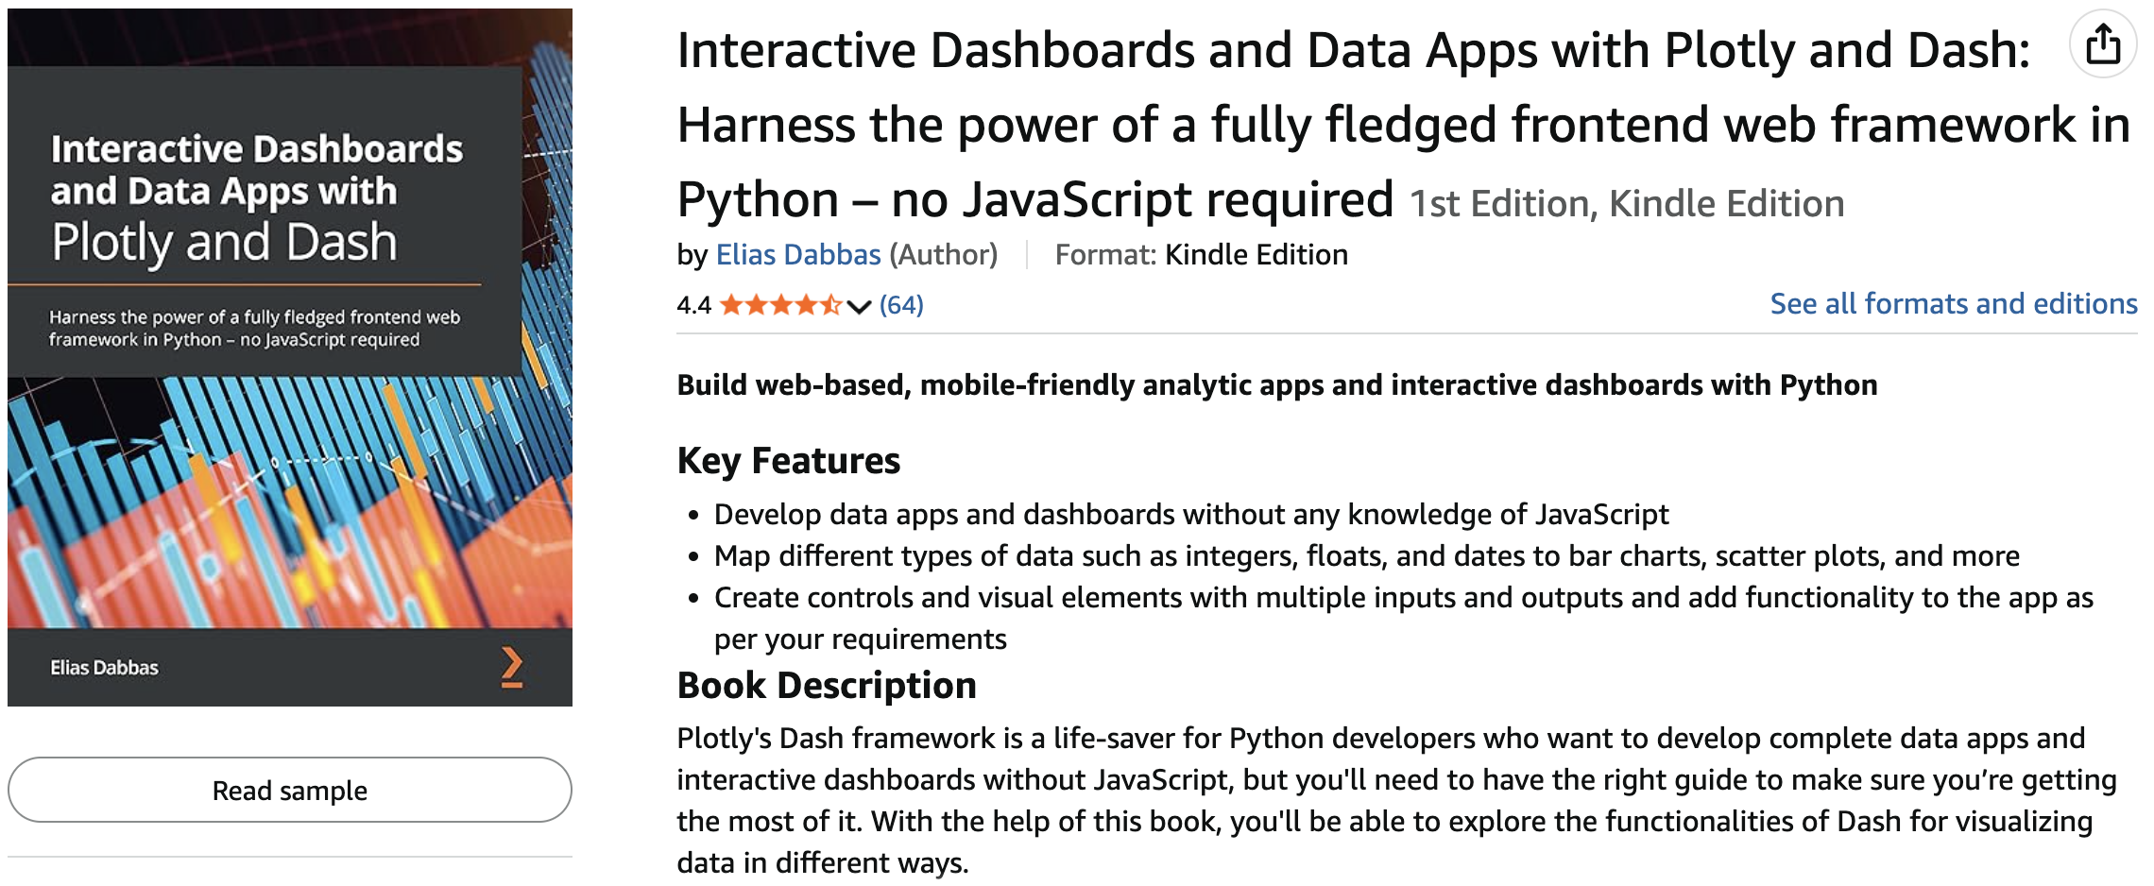

Slide 5
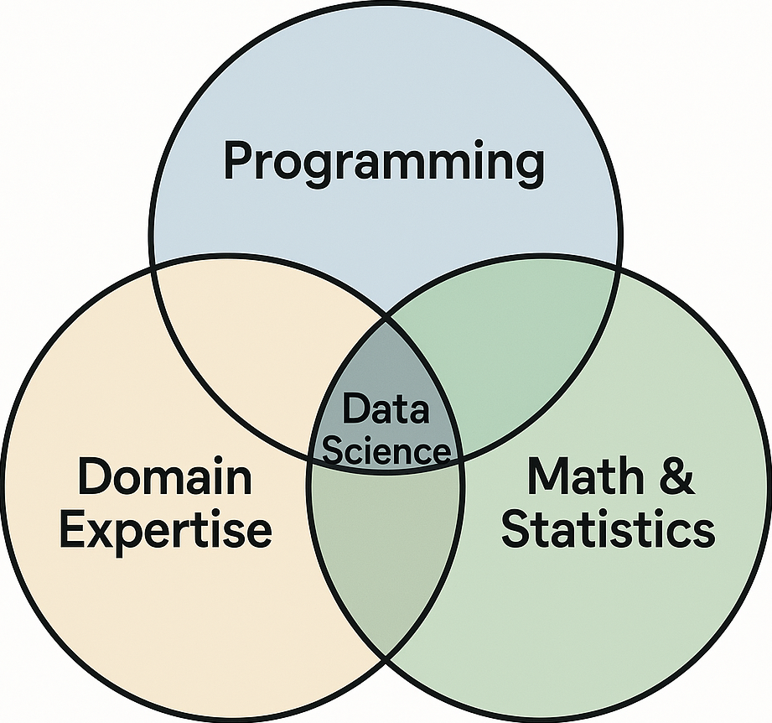
What?
Image: Drew Conway, remade with ChatGPT

Slide 6
What?
Domain Expertise (SEO, finance, geology, etc): This drives the other elements by providing answers to “what” and “why” questions
Programming: basic programming skills (not software development), questions of “how”
Math and Statistics: average, maximum, minimum, modeling, machine learning, deep learning, etc.

Slide 7
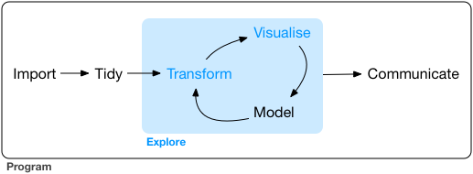
What?
Tasks and skills
Image: R for Data Science book

Slide 8
What?
Tasks and skills
Import: read CSV file, crawl a website, get API data
Tidy: reshape a table, merge tables
Transform: sort, groupby (pivot tables), filter
Visualize: charts, interactive apps
Model: linear model, inference, clustering
Communicate: reports, dashboards, recommendations
Program: perform all tasks by writing code

Slide 9
How?

Slide 10
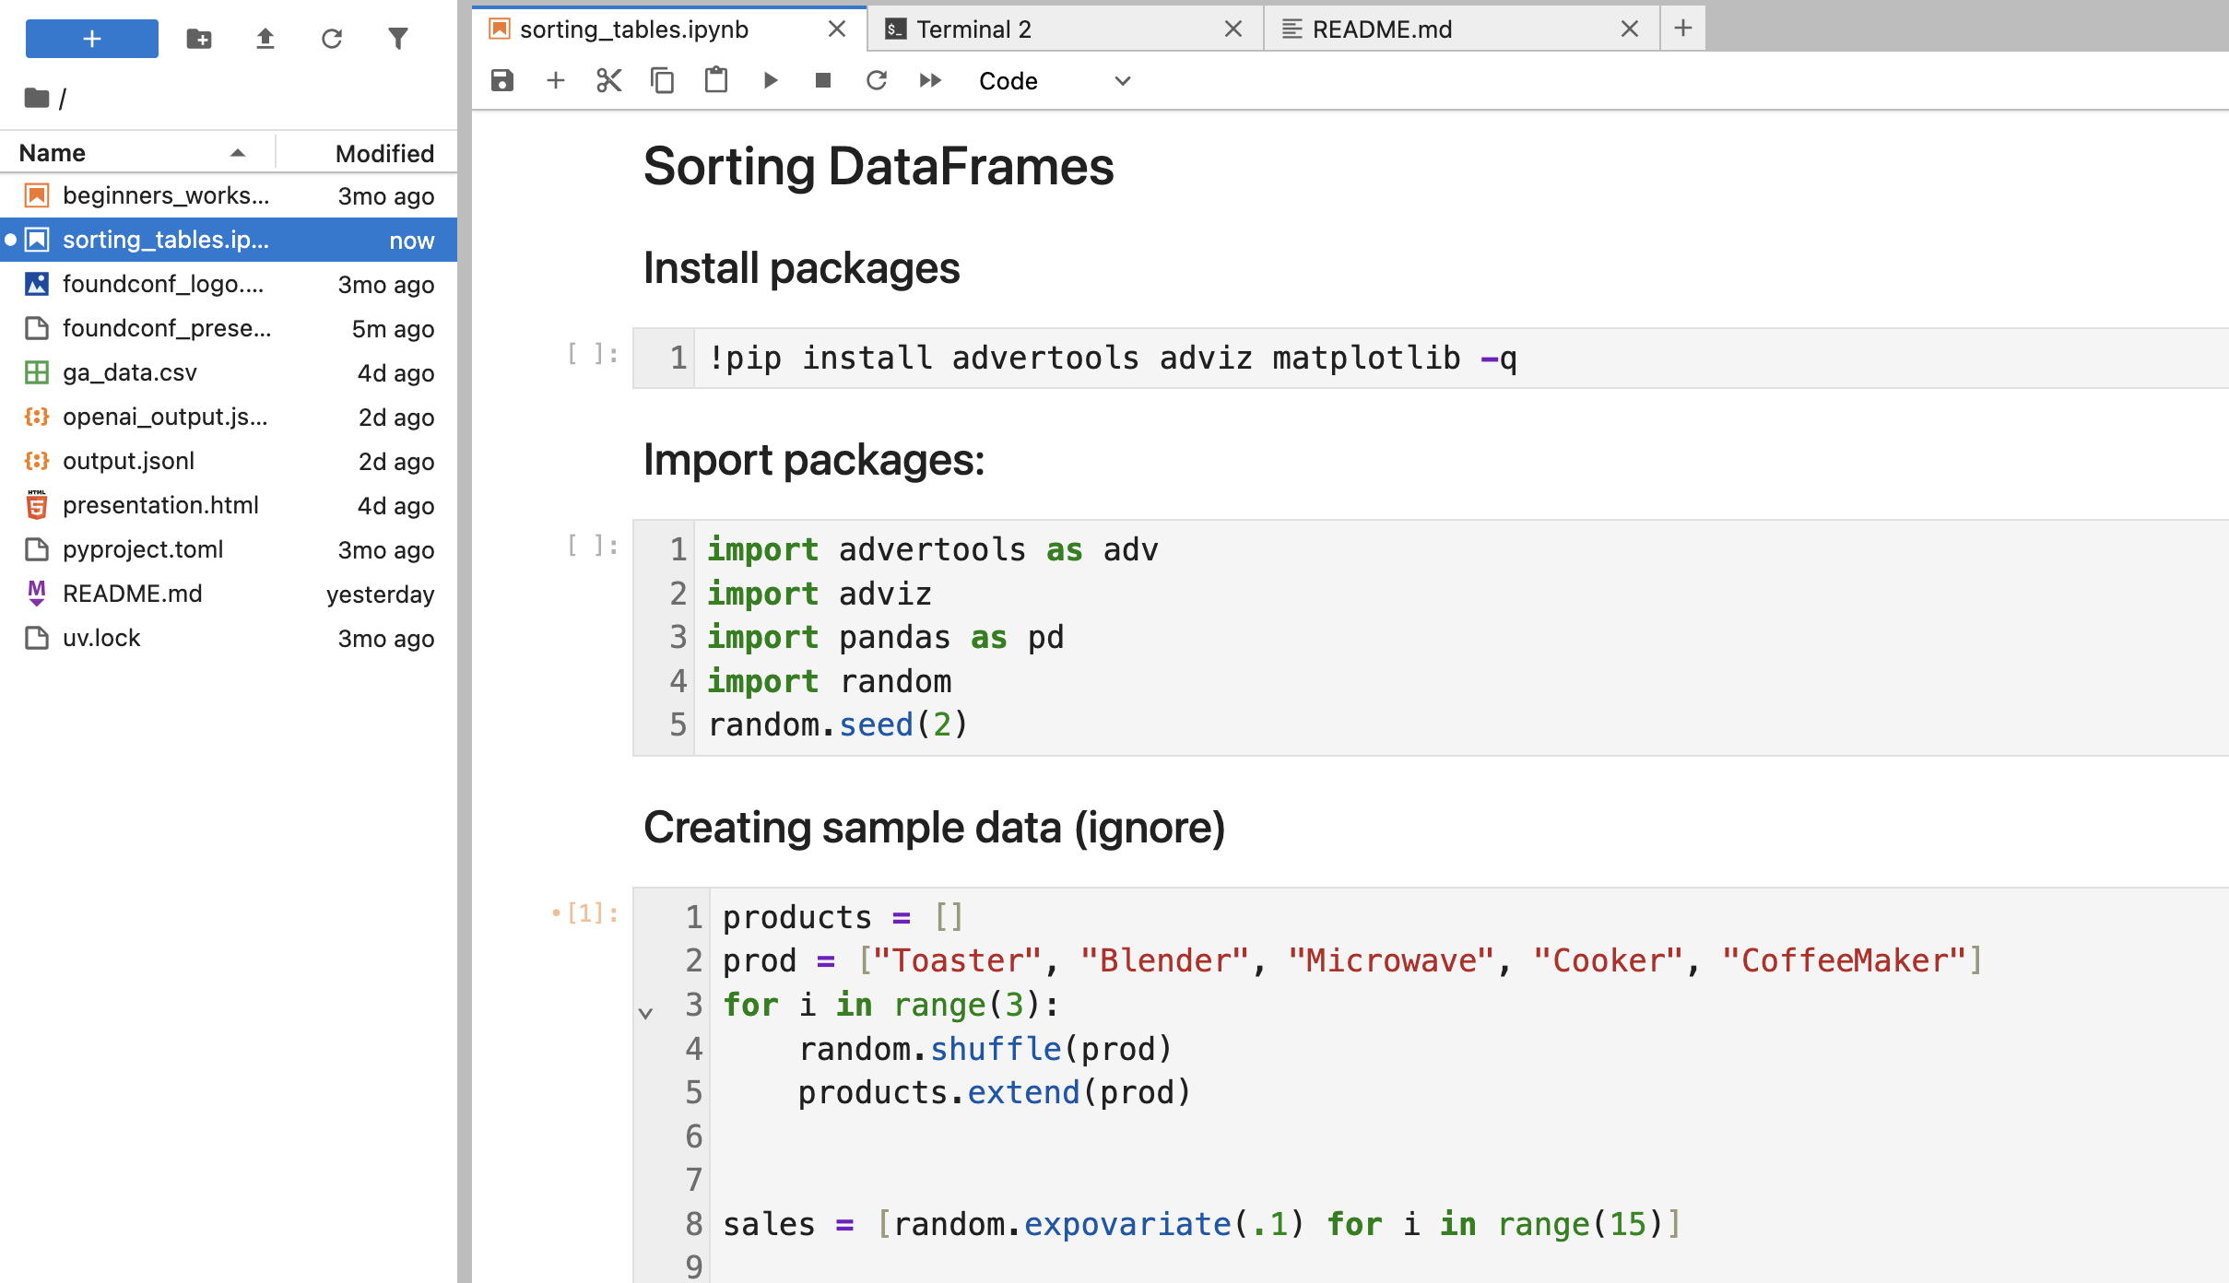
How?
Writing (Python) code in a “Jupyter Notebook”

Slide 11
Minimum viable knowledge

Slide 12
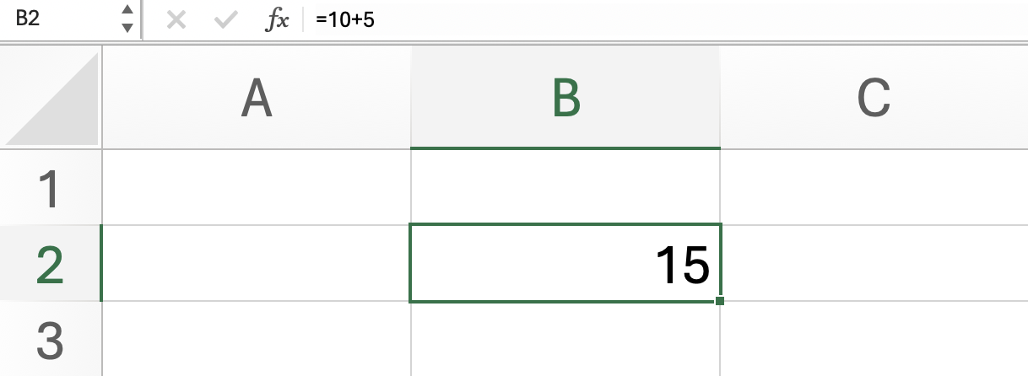
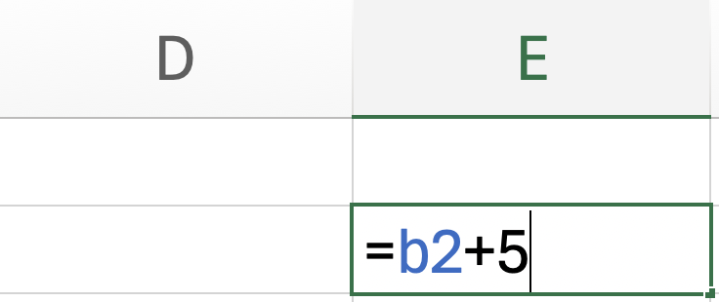
Variables
name = value
B2 = 10+5
name = value (potentially a complex formula)
= is the “assignment operator”

Slide 13
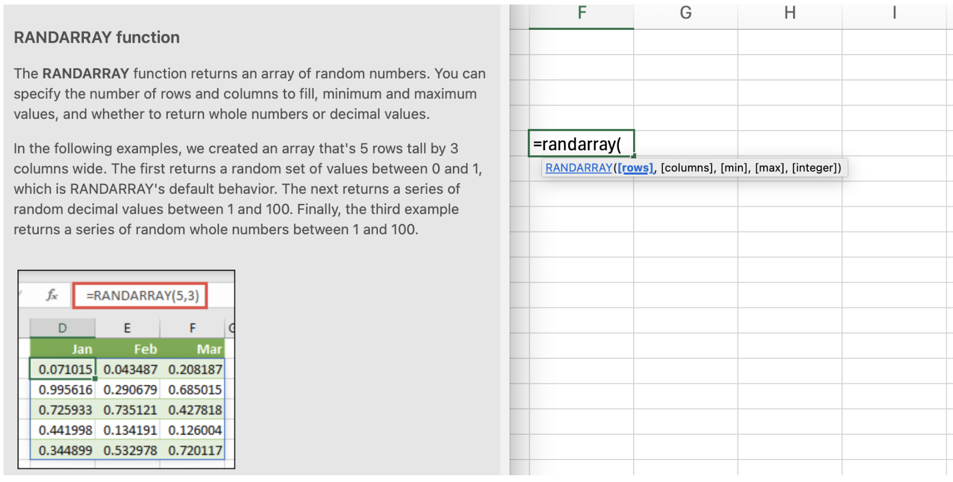
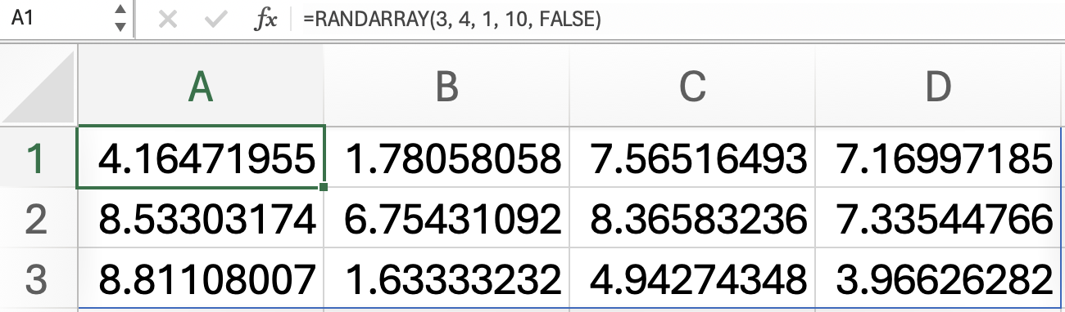
Functions
=FUNCTIONNAME(parameter_1, parameter_2, parameter_3, …)

Slide 14
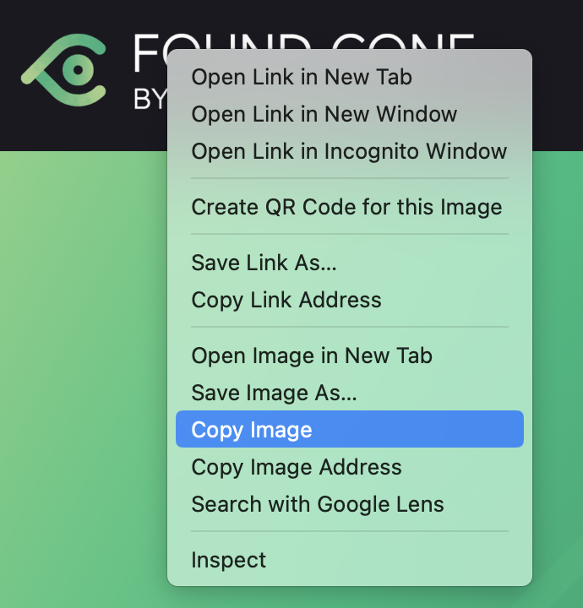

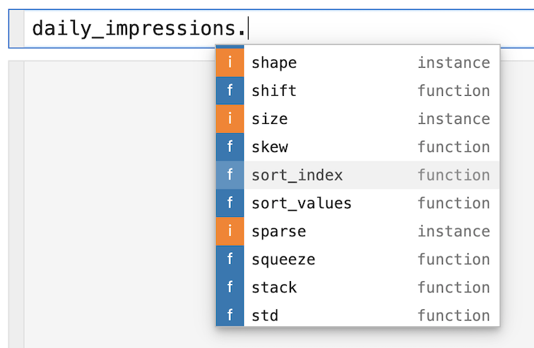
Right-click (contextual functions)
Dot-notation
Available actions depend on the type of object

Slide 15
Jupyter Notebook

Slide 16
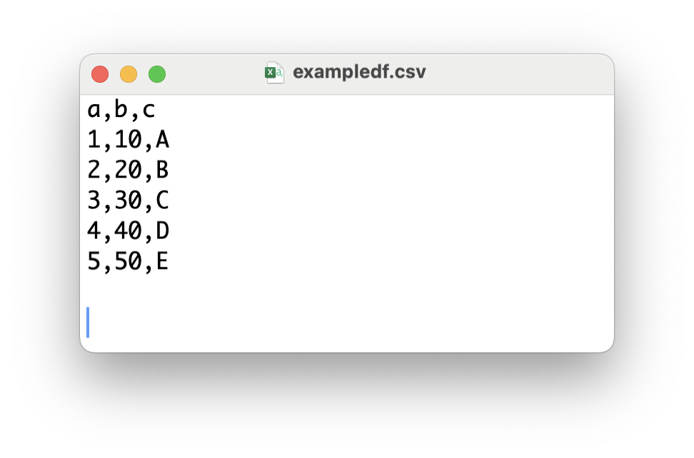
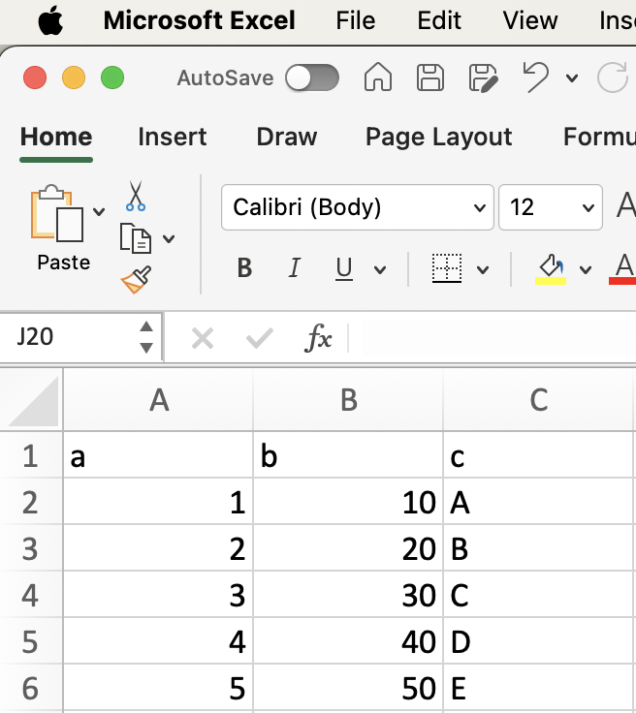
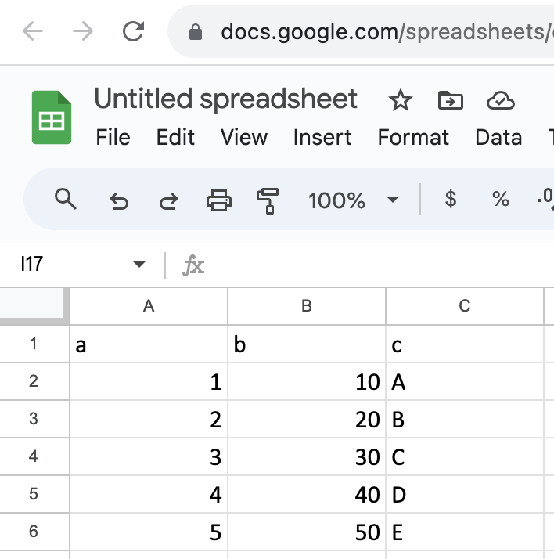
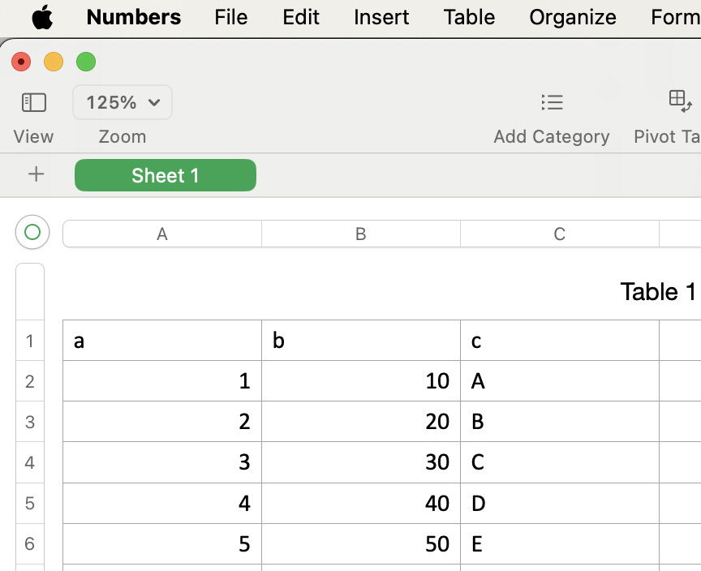
File format
Supporting applications

Slide 17
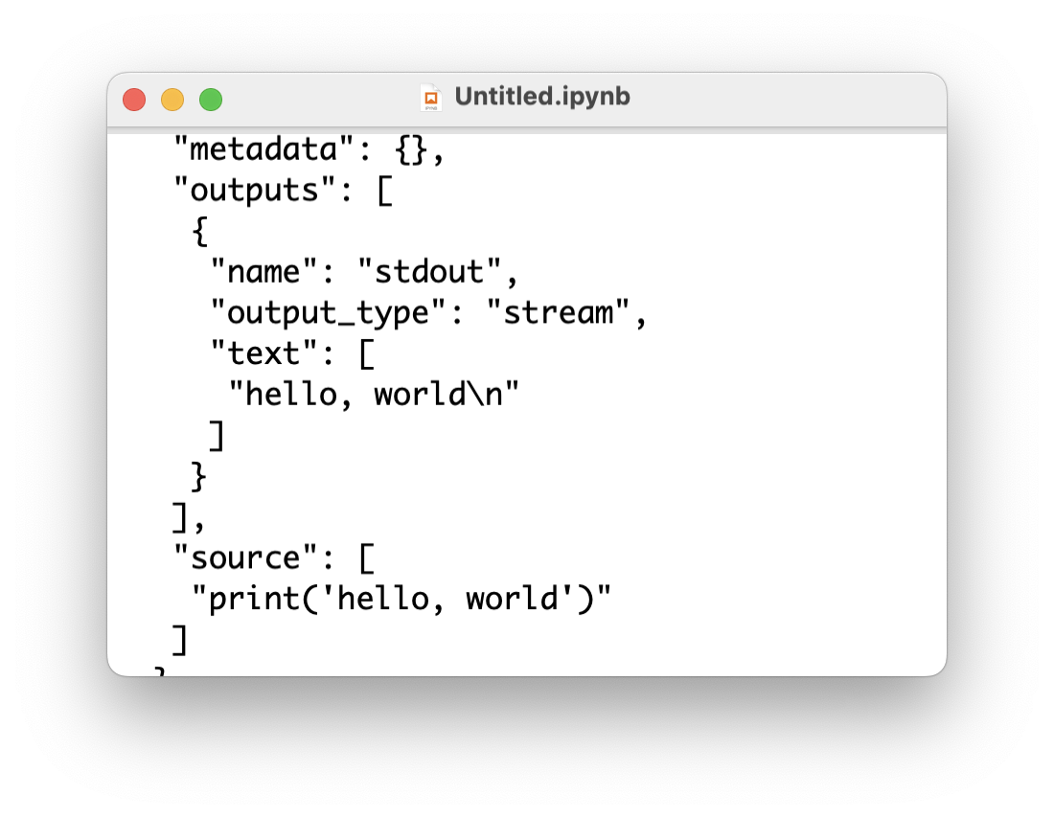
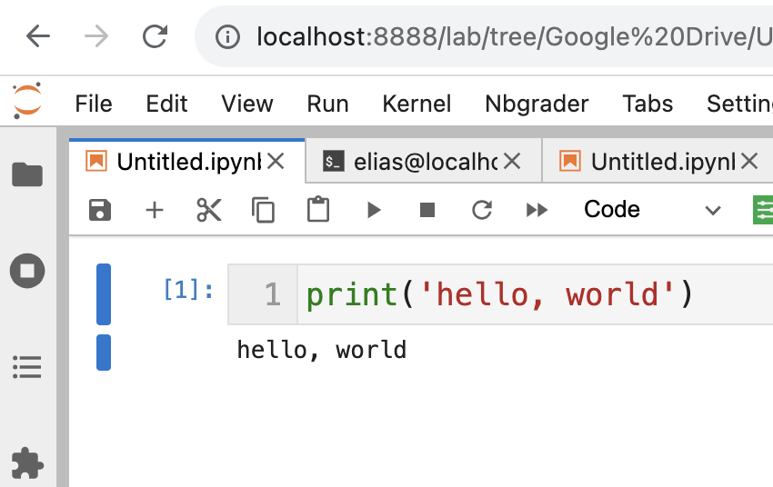
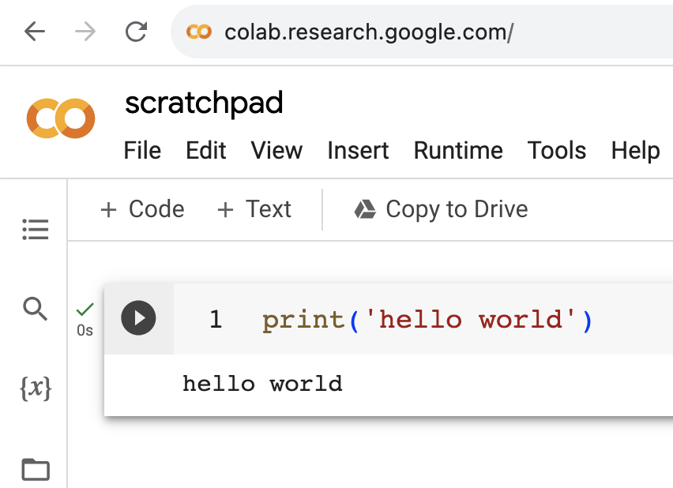
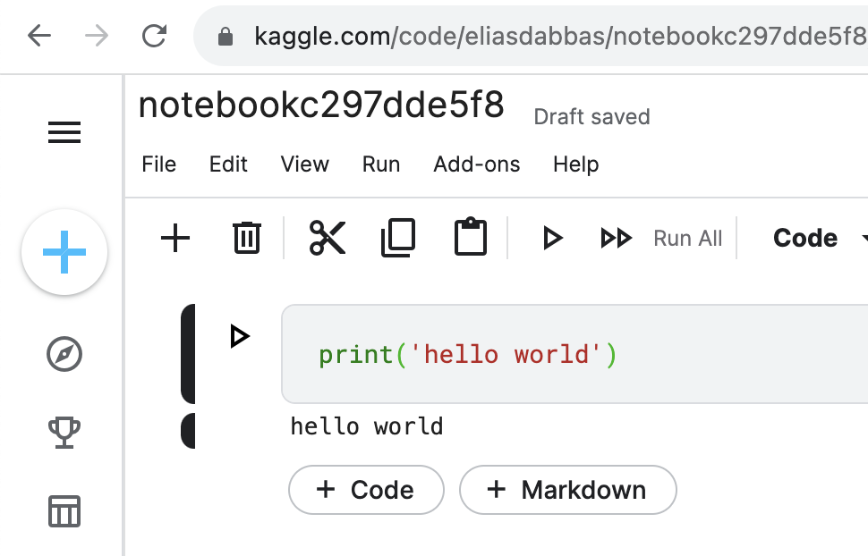
File format
Supporting applications
JupyterLab
Google Colab
Kaggle
https://colab.research.google.com/
Start here (online, no setup required)
.ipynb
Interactive Python notebook
Jupyter Notebook

Slide 18
Examples

Slide 19
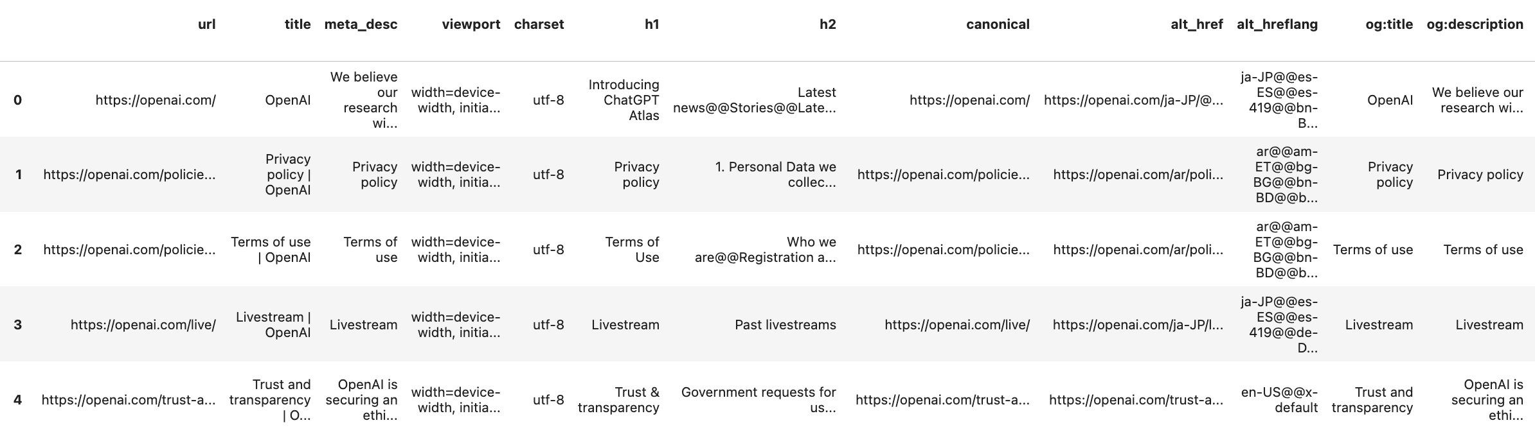
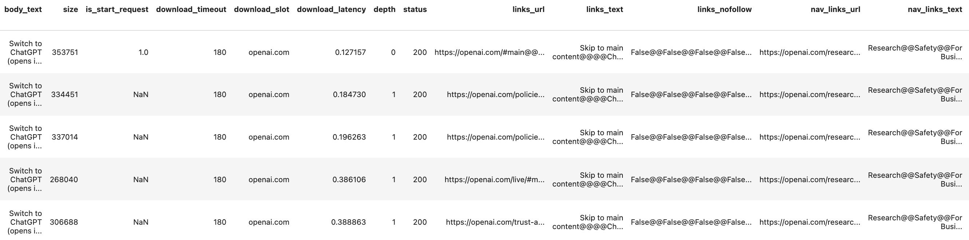
Crawling a website
One line of code to crawl an entire website
Many more columns!

Slide 20
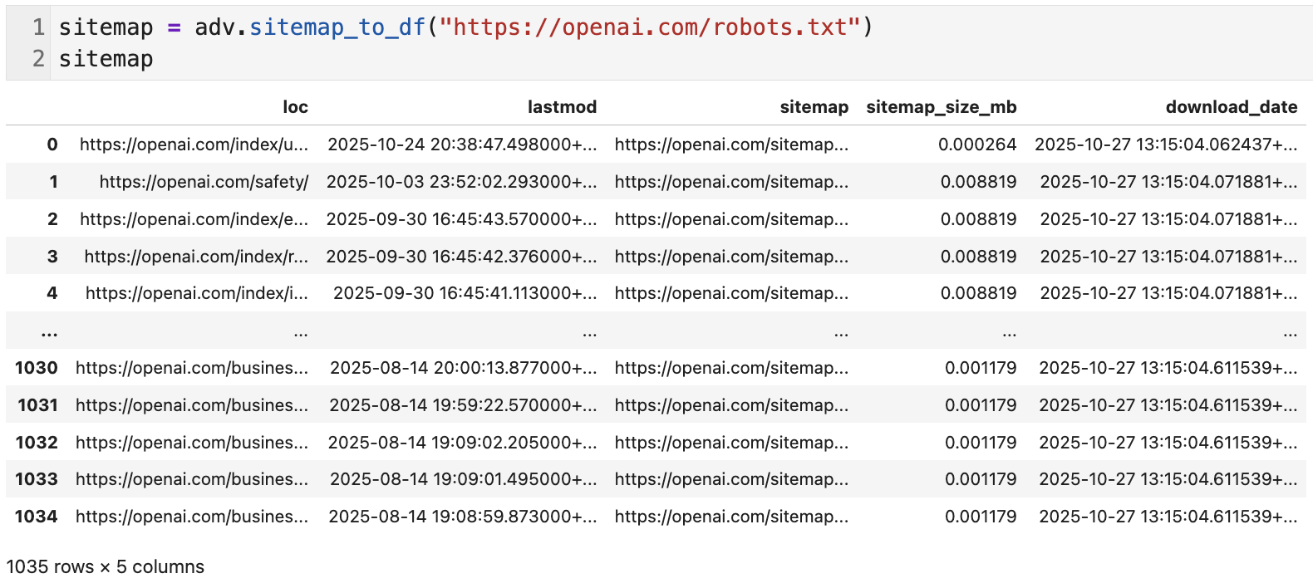
Fetching/analyzing XML sitemaps

Slide 21
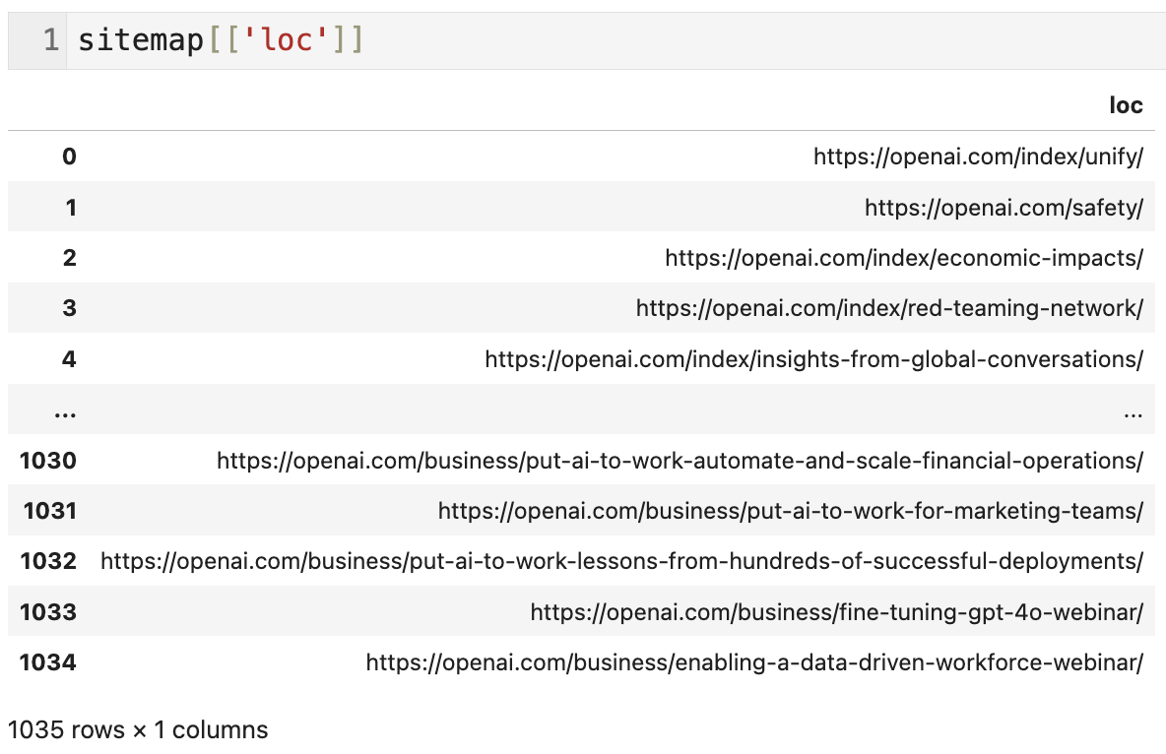
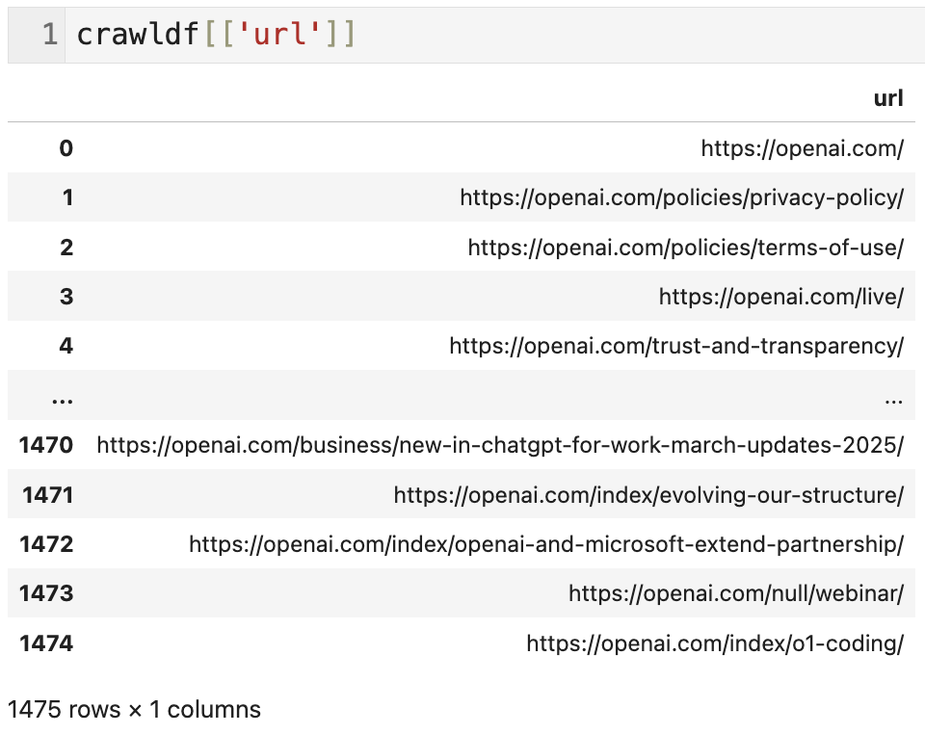
Compare sitemap to crawled URLs

Slide 22
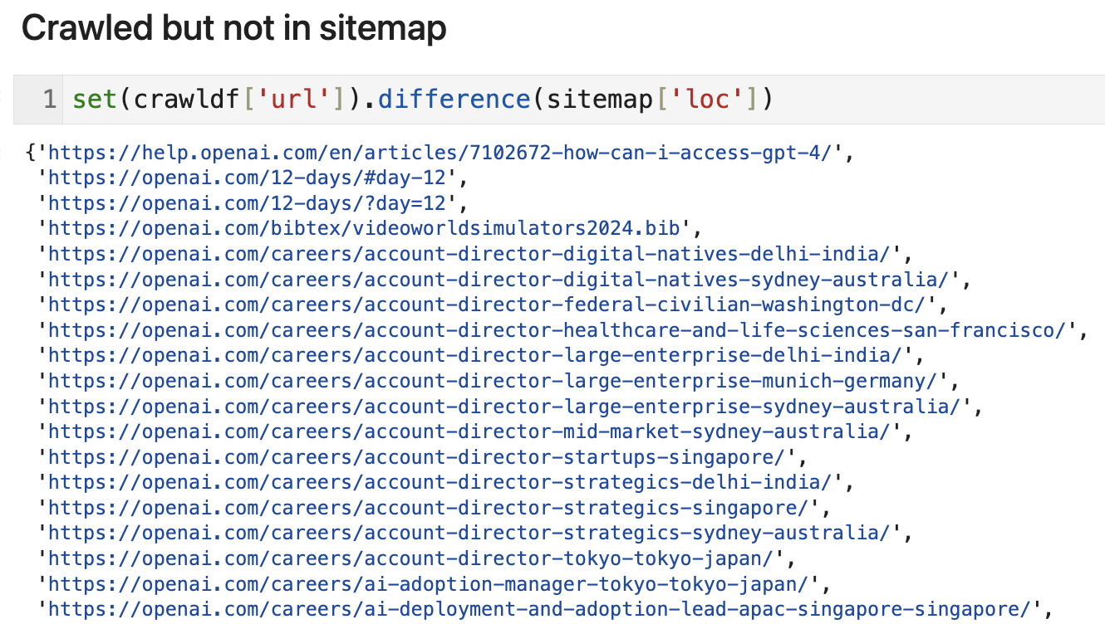
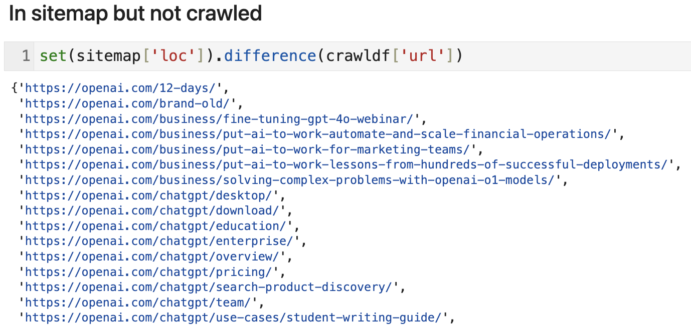
Compare sitemap to crawled URLs
857 URLs
237 URLs

Slide 23
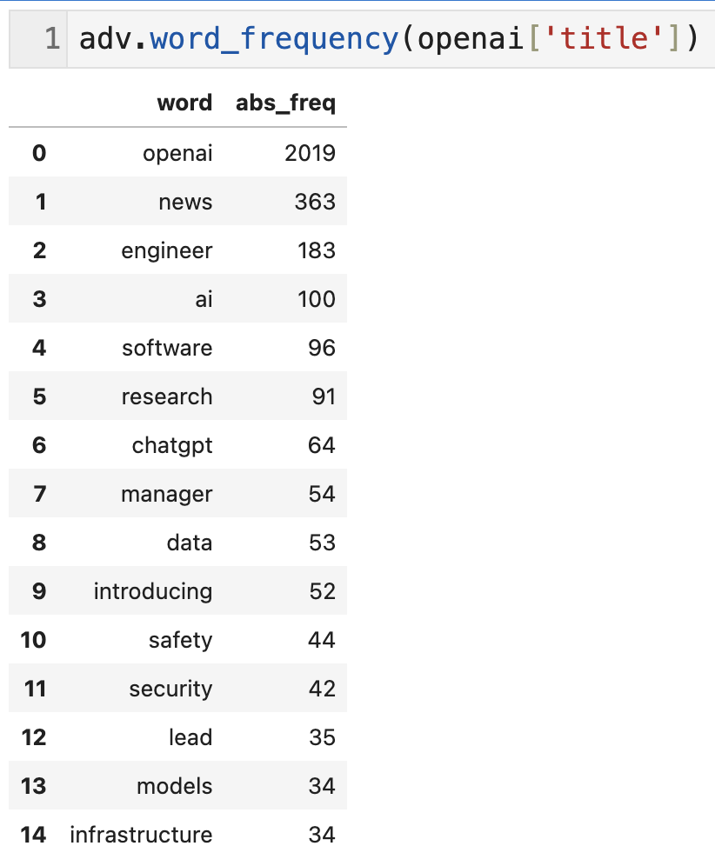
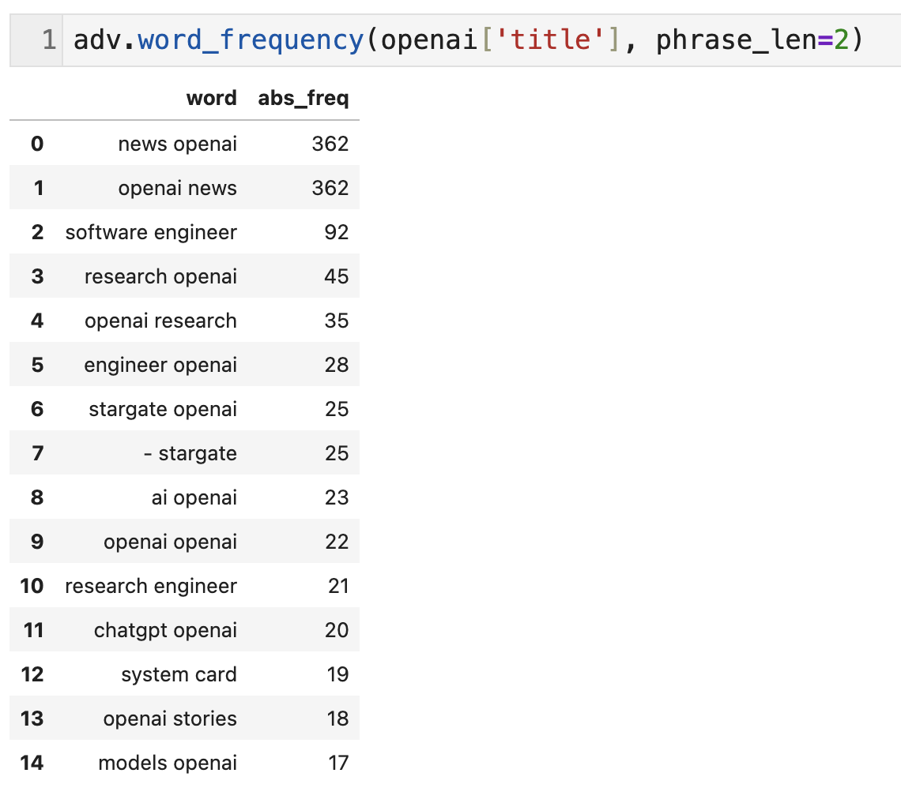
Text Analysis
adv.word_frequency: ngram analysis of a list of phrases, optionally weighted by a metric

Slide 24
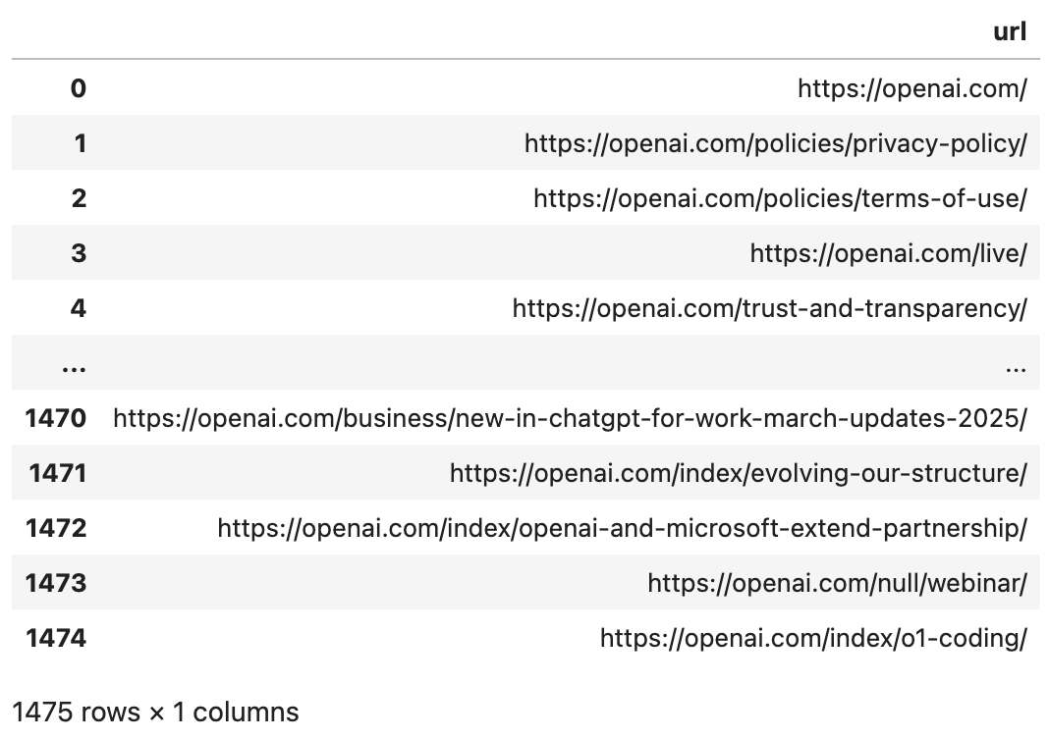
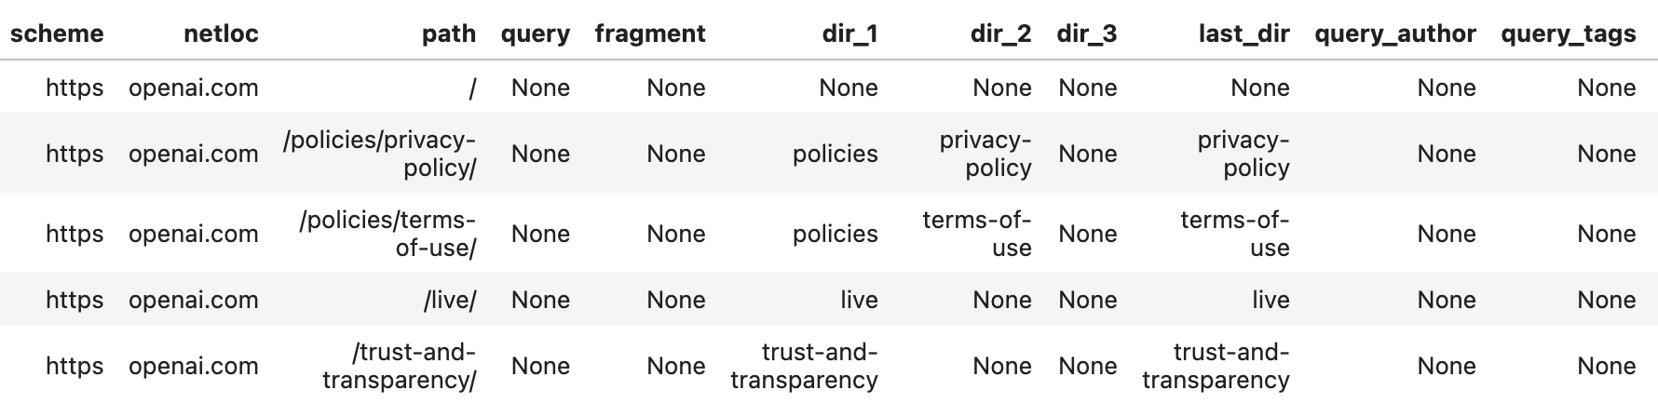
URL structure analysis
adv.url_to_df(openai[“url”])

Slide 25
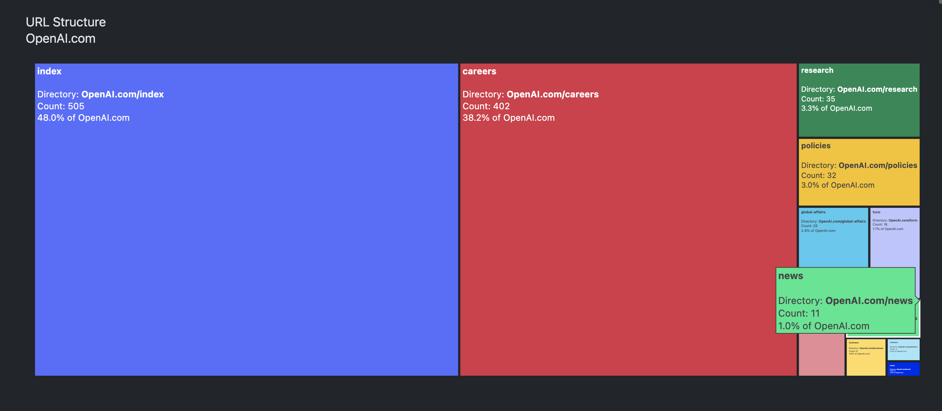
adviz.url_structure()

Slide 26
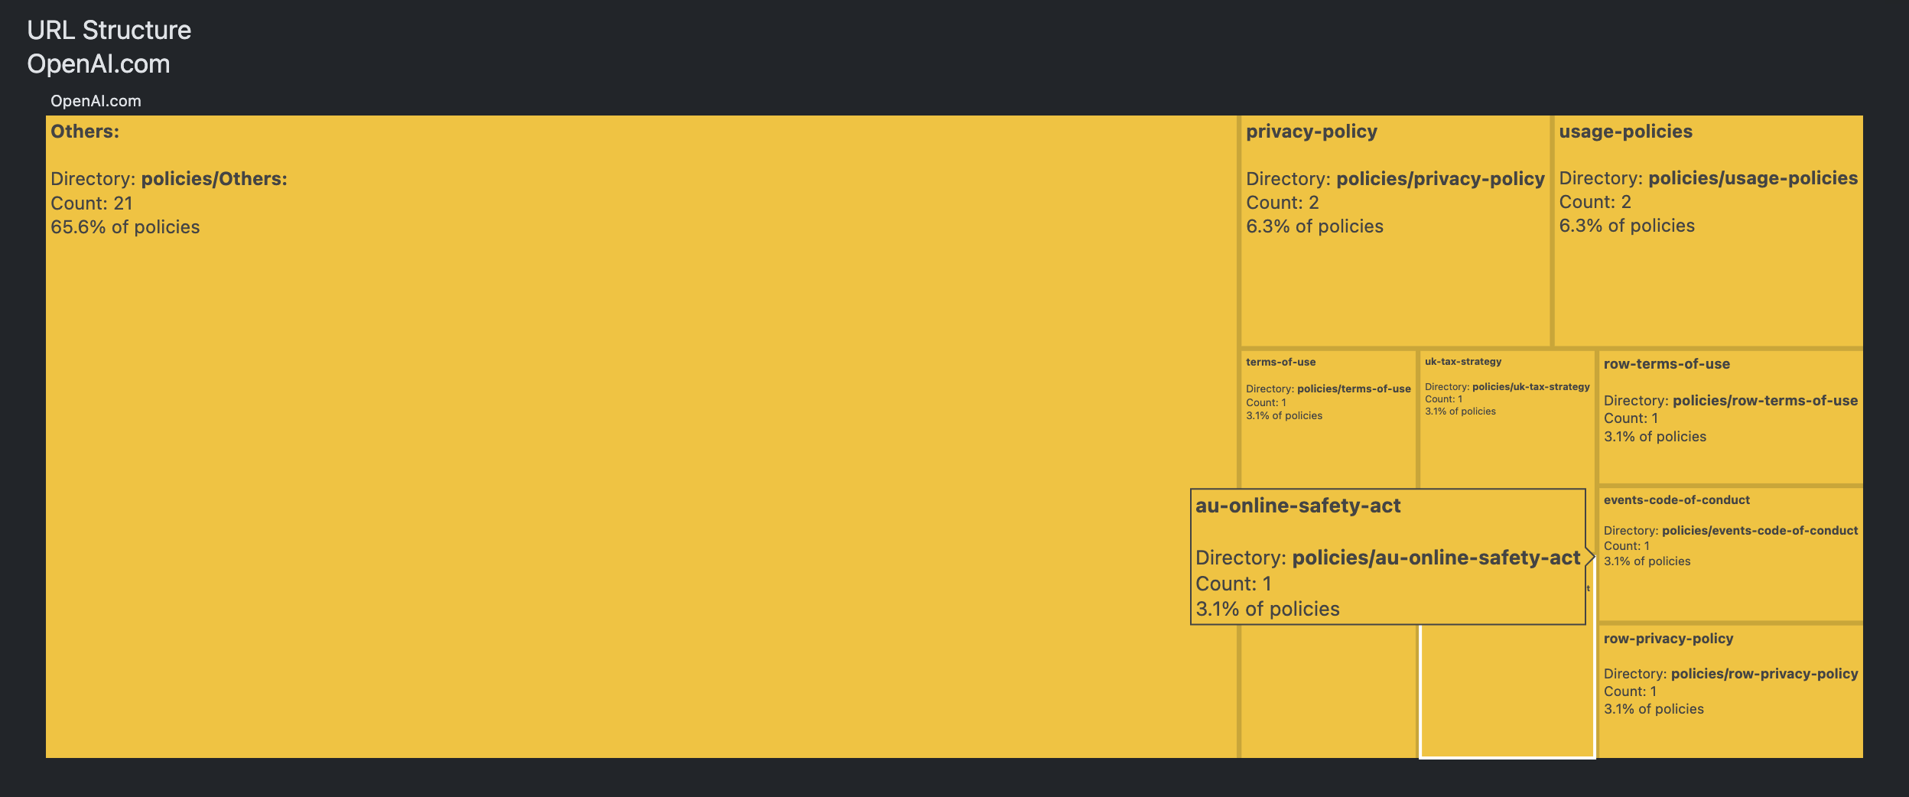
adviz.url_structure()
Drill-down to the next level (folder)

Slide 27
Why?

Slide 28
Why work with code? vs. moving your mouse and clicking on the screen

Slide 29
Auditability
We need to trust that the work we do is correct

Slide 30
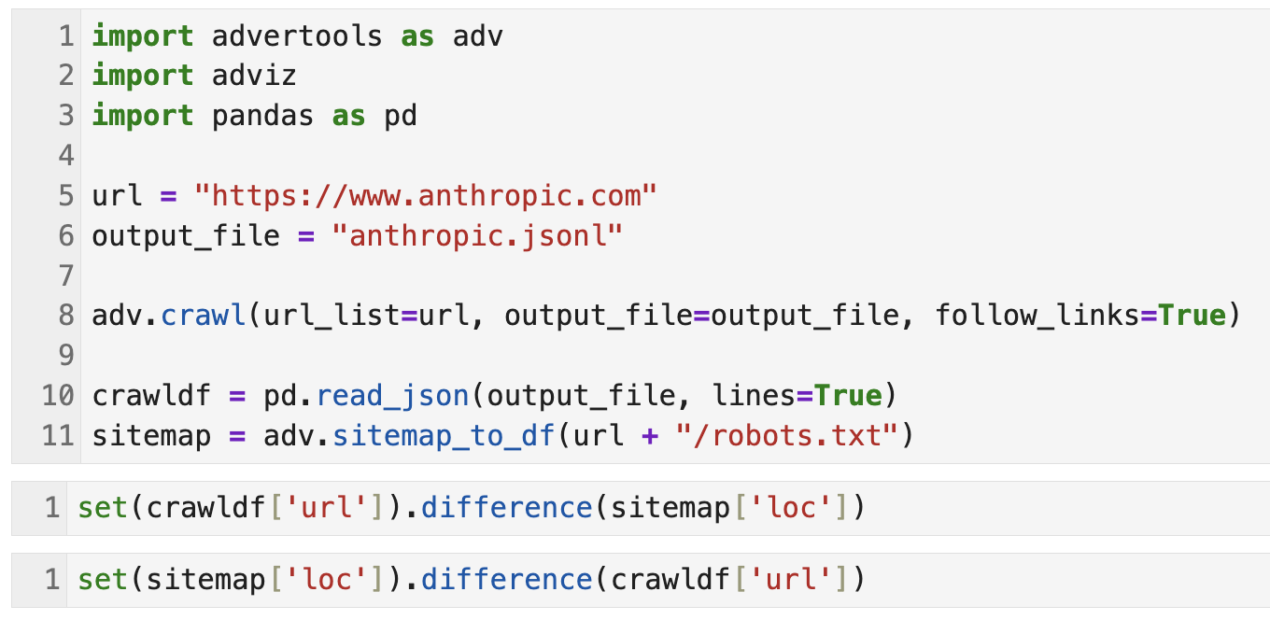
Code to compare sitemap vs crawled URLs
Check every step of the process, verify things are correct, ask questions

Slide 31
Scaling
Horizontal: reusing the same workflow across projects

Slide 32
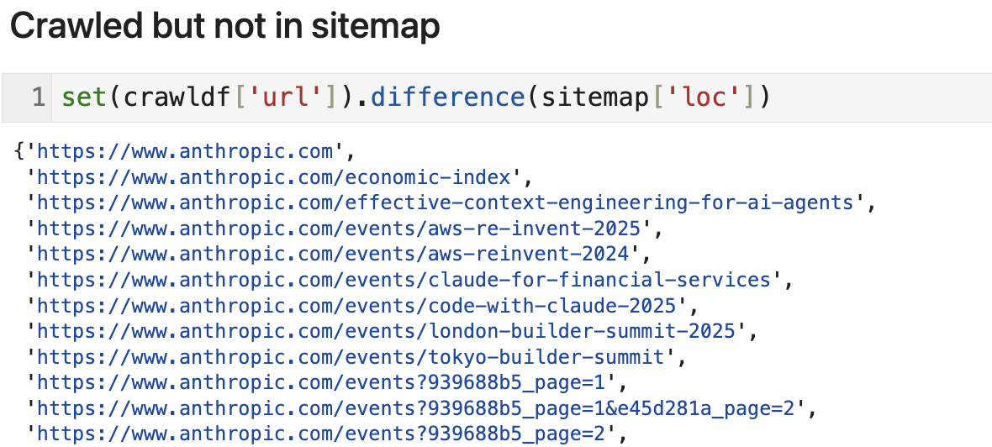
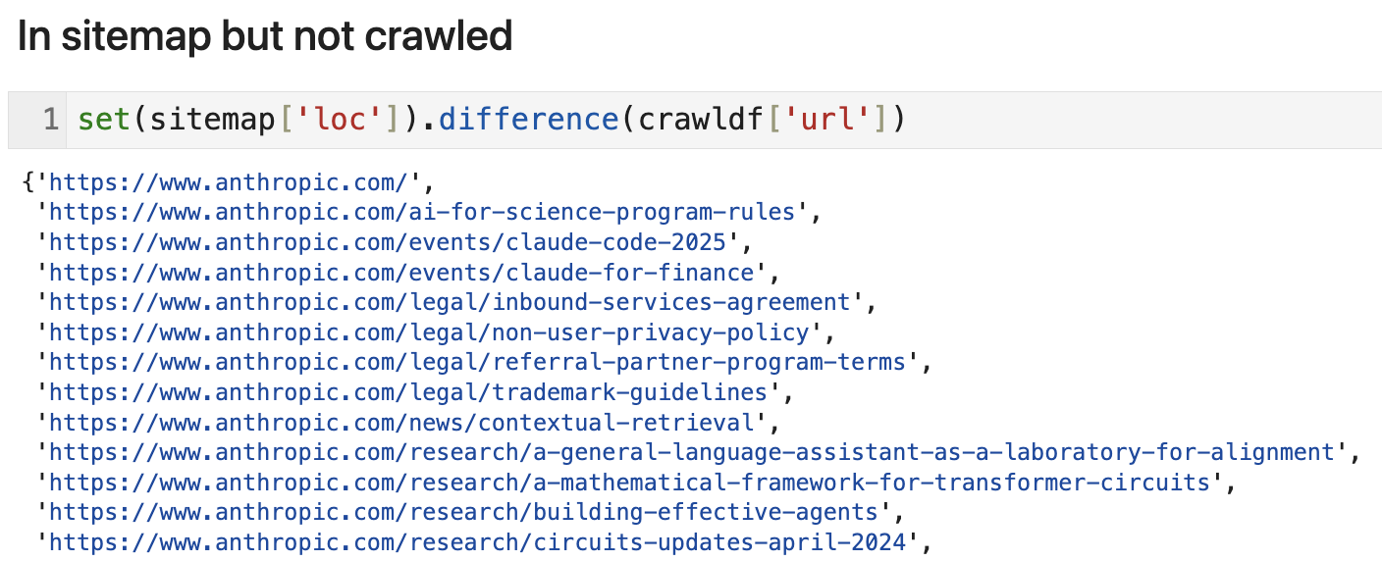
Run the exact same process for another domain

Slide 33
Scaling
Vertical: improving the same workflow to make it more powerful

Slide 34
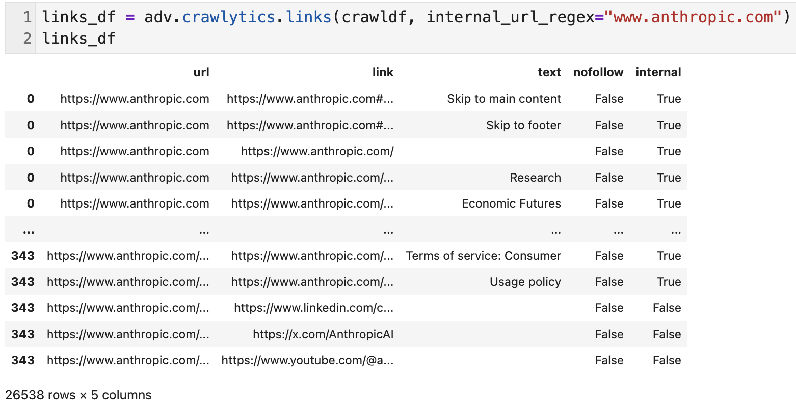
Analyze links
Get a mapping of all links on the site (from/to)

Slide 35
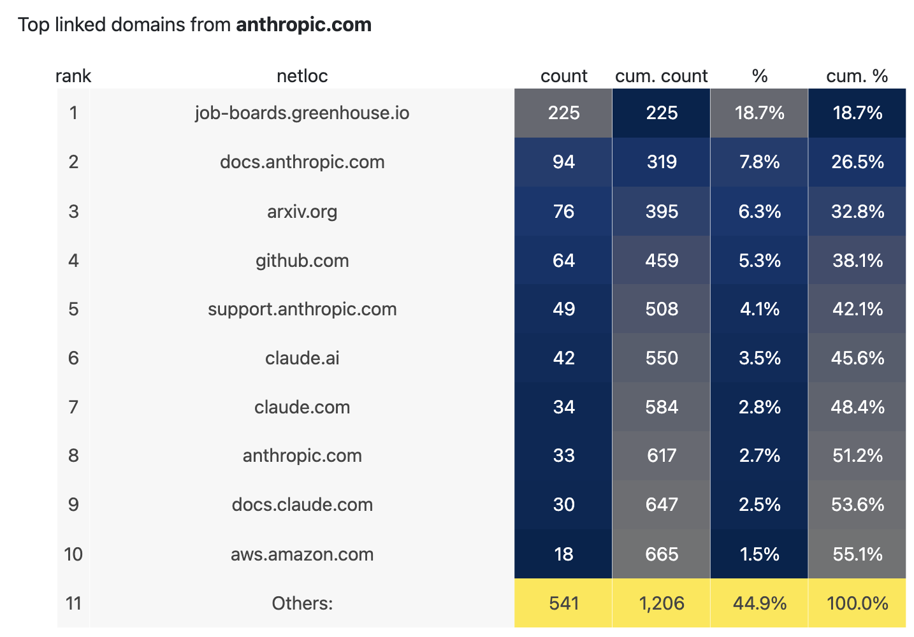
Analyze links
Top linked external domains (de-duplicated)

Slide 36
Reproducibility
Raw data + code = results
Should be the same every time (like scientific experiments)

Slide 37
Full customization

Slide 38
A Great Tool
Provides great charts
Uncovers insights
Makes interesting reports
Allows you to ask any question & perform any task you want with your data

Slide 39
Automation & packaging
Let’s make that whole workflow into a single function

Slide 40
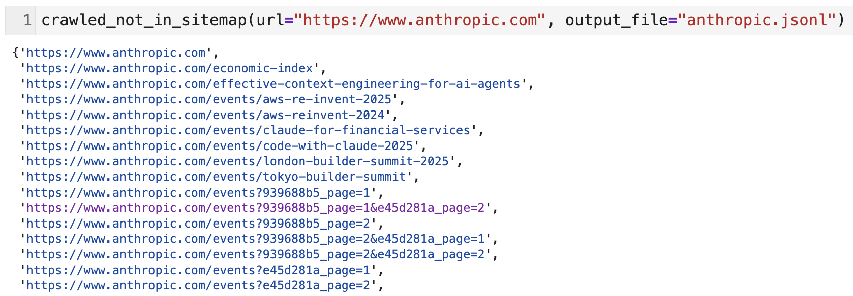
Create a single function
crawled_not_in_sitemap(“example.com", “output.jsonl”) a single command that goes through all the steps

Slide 41
Packaging
A set of functions that you can use without having to worry about their code do_this(a)
do_that(b, c)

Slide 42
Introducing advertools
A Python package that has various functions and tools dedicated to SEO, and digital marketing open-source and free

Slide 43
Getting started with advertools
Installation:
pip install advertools
Importing:
import advertools as adv
Running a function:
adv.function_name(param_a=val_a, param_b=val_b)

Slide 44
Robots.txt files
adv.robotstxt_to_df(): convert a robots file (or a thousand) to a DataFrame
adv.robotstxt_test(): run tests in bulk for a combination of URLs and user-agents

Slide 45
XML Sitemaps
adv.sitemap_to_df(): convert a sitemap to a DataFrame
Supports normal sitemaps and sitemap index files
Supports robots.txt files (discovers all listed sitemaps and combines them together)
Runs concurrently (very fast)
Speed can be configured easily

Slide 46
Crawling
Three crawlers
adv.crawl(): normal SEO crawler
Spider and/or list mode
Get all request/response headers
Set granular rules on speed
Much more
adv.crawl_headers(): send HEAD requests in bulk to a set of known URLs, get status codes and all available response headers
adv.crawl_images(): download all images from a list of URLs, optionally set limits for minimum width/height, and name regex

Slide 47
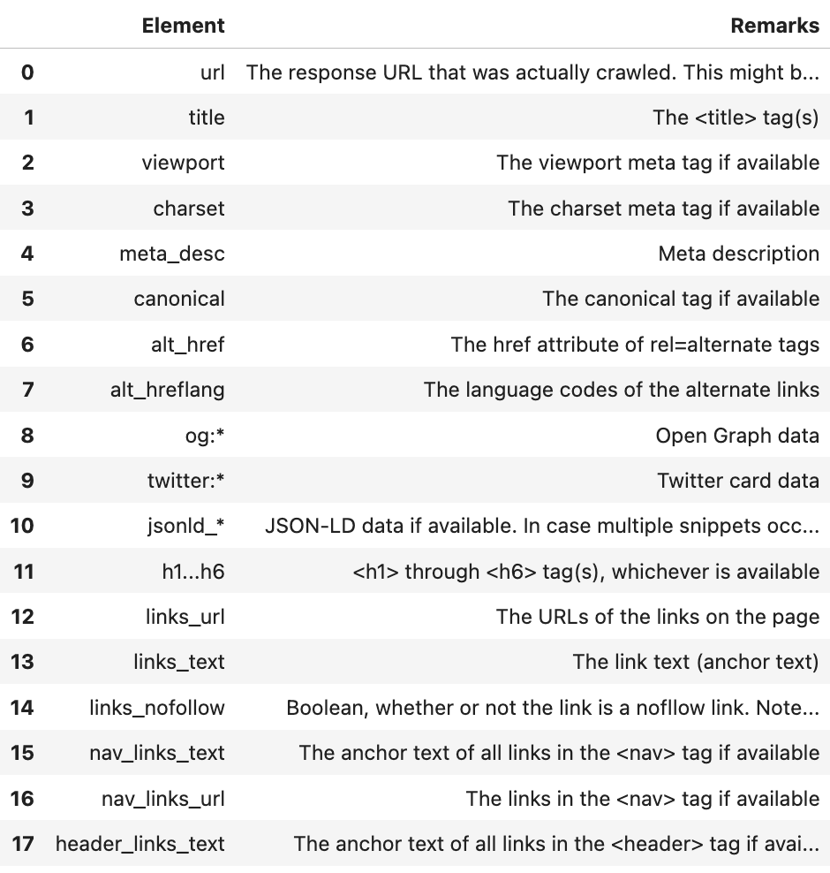
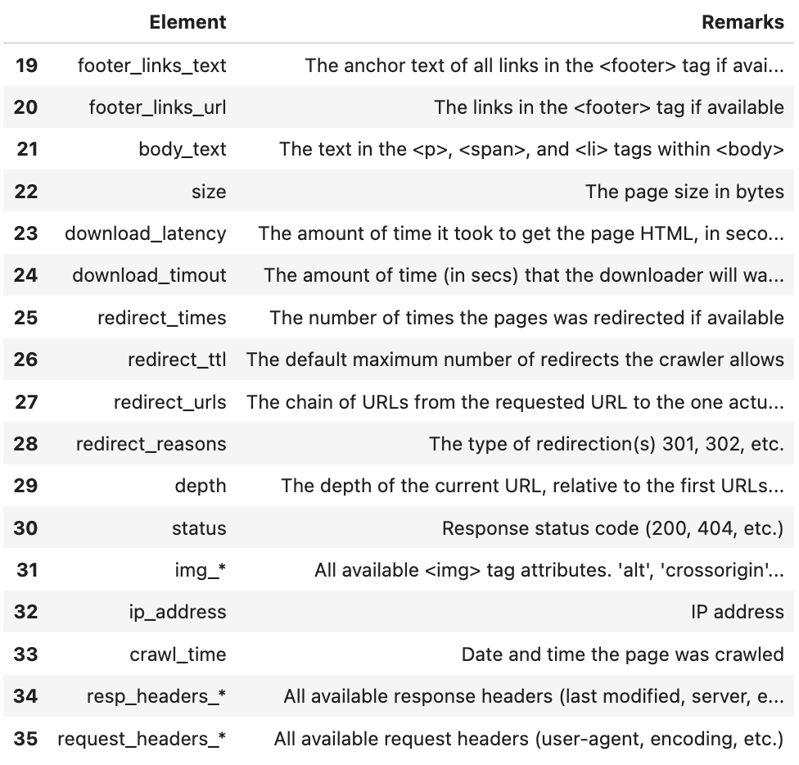
Crawling
advertools crawler extracted (groups of) columns
adv.crawl(): normal SEO crawler
Spider and/or list mode
Get all request/response headers
Set granular rules on speed
Much more
adv.crawl_headers(): send HEAD requests in bulk to a set of known URLs, get status codes and all available response headers
adv.crawl_images(): download all images from a list of URLs, optionally set limits for minimum width/height, and name regex

Slide 48
URL Analysis
adv.url_to_df: split a list of URLs to their components and return a DataFrame

Slide 49
Log file analysis
adv.logs_to_df: comprehensive parsing of log files
Parses every single field into its components (URLs, referer and request, user-agent, status codes, etc)
Extremely granular analysis of log data
Automatic compression with parquet format

Slide 50
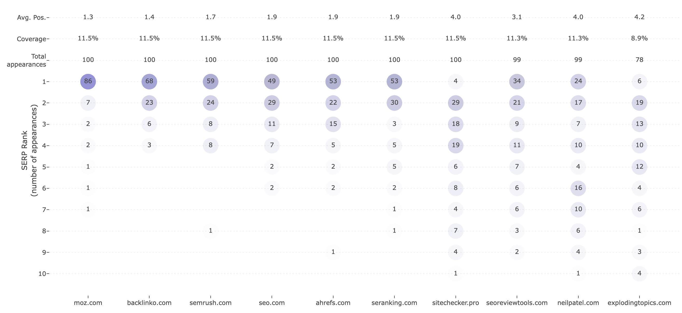
adviz
advertools vizualizations
adviz.serp_heatmap()

Slide 51
The DataFrame Mentality™
© Ray Grieselhuber

Slide 52
AI/LLMs and Data Science

Slide 53
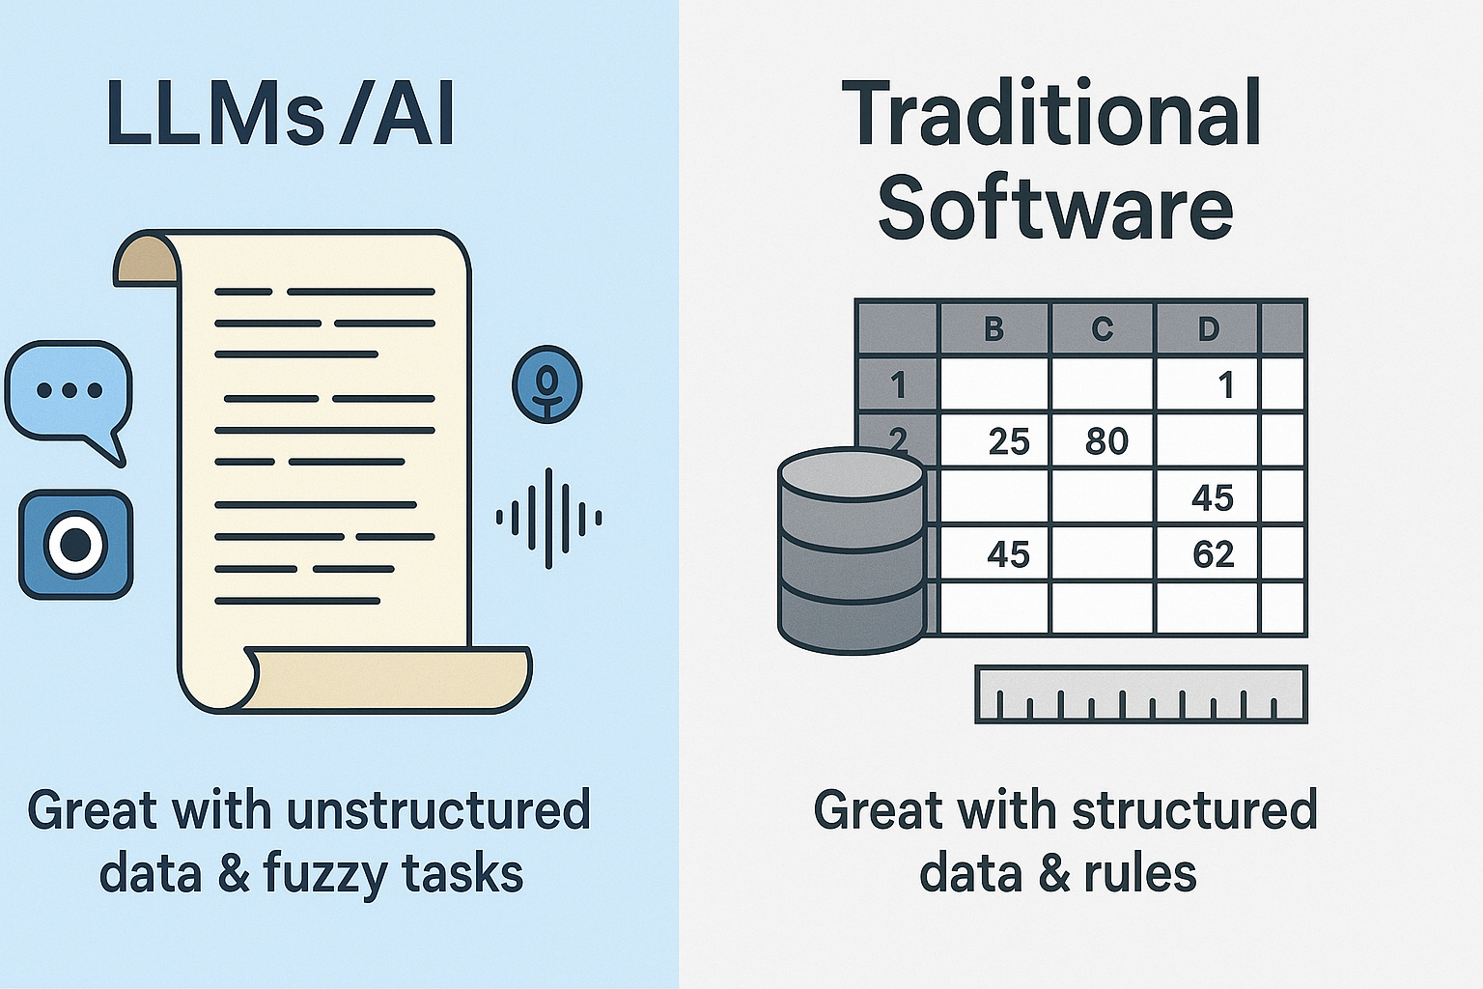
The dance between (un)structured tasks
Image: ChatGPT

Slide 54
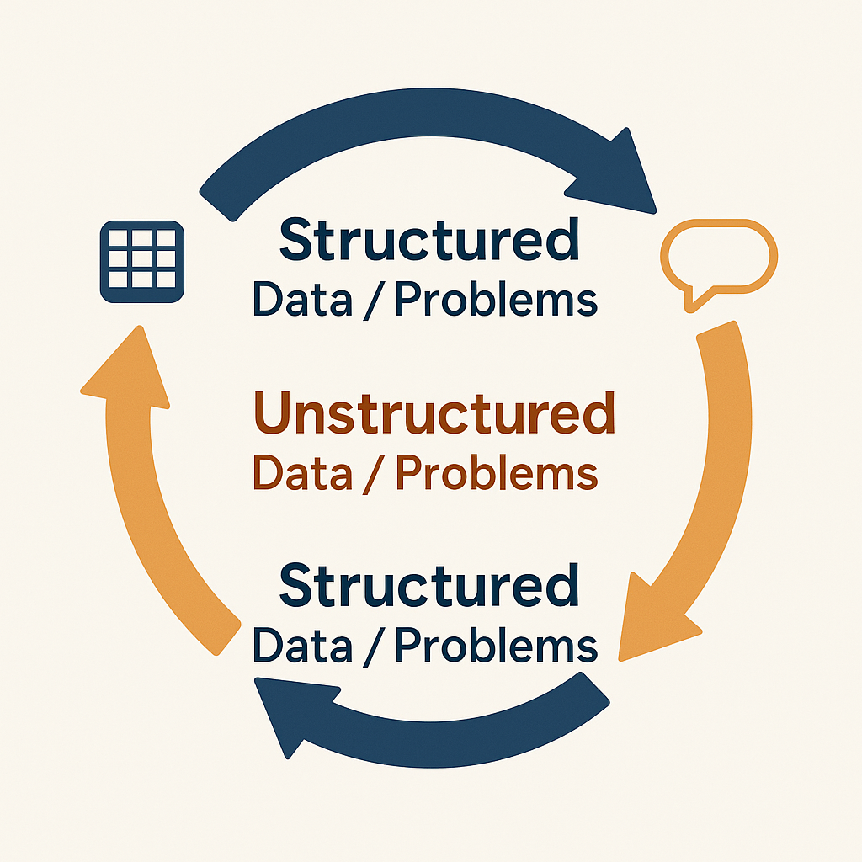
The Cycle
Get unstructured data
Provide some structure/context with traditional methods
Extract structured data
Use traditional software for processing
Repeat
Image: ChatGPT

Slide 55
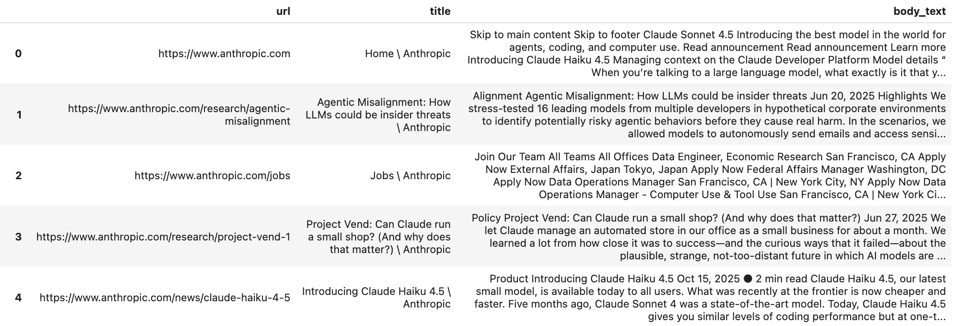
Crawled website’s body text

Slide 56
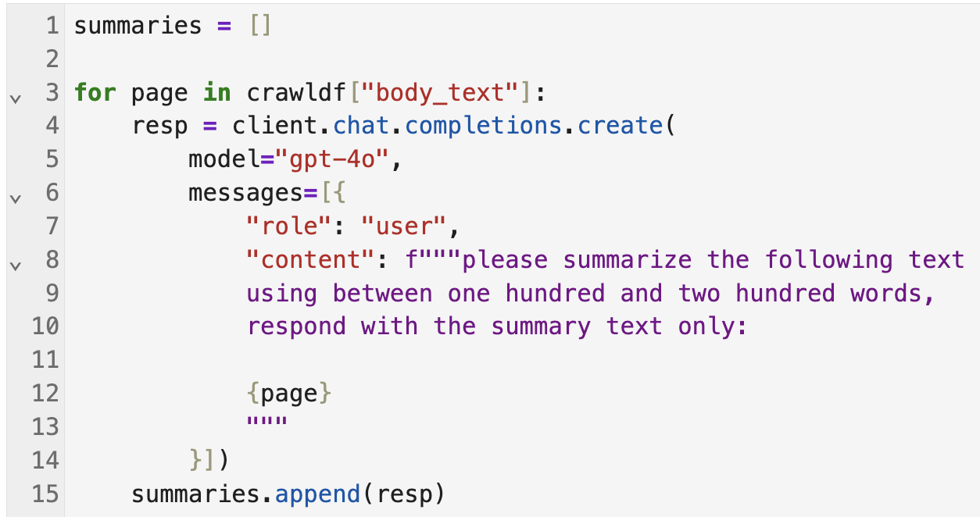
Summarize in bulk with AI
Create an empty list summaries
Go through all the body_text column cells in the crawldf
Send the content to ChatGPT with a prompt asking it to summarize it
Append the summary text to summaries

Slide 57
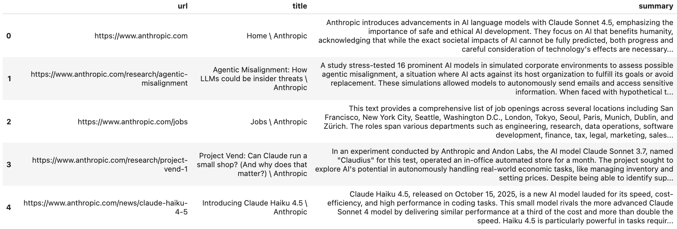
Crawled website’s body text

Slide 58
90% of My Skills Are Now Worth $0
...but the other 10% are worth 1000x
Kent Beck (software developer)
https://x.com/KentBeck/status/1648413998025707520

Slide 59
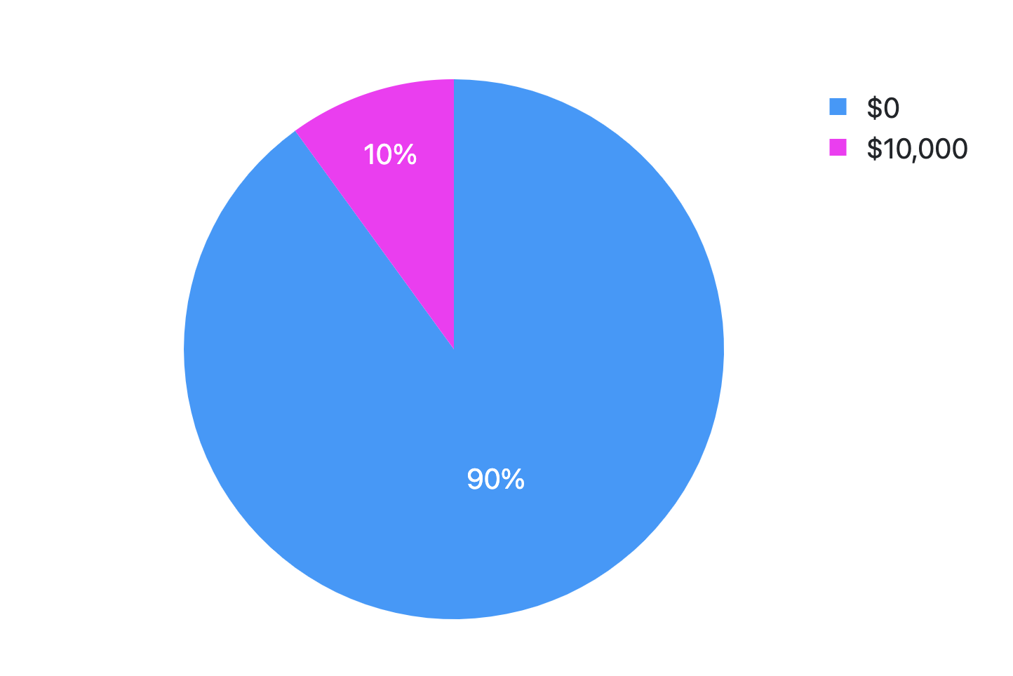
90% of My Skills Are Now Worth $0
...but the other 10% are worth 1000x

Slide 60
90%
$0
10%
$10,000
Memorizing which package does what
Knowing the syntax of the functions that you use
Knowing what methods are available to Python dictionaries
Writing code
Asking the right, strategic, useful questions
Making a good evaluation of the given output
Making decisions on next steps
Telling the LLM to write code

Slide 61
“AI doesn’t do it end-to-end.
It does it middle-to-middle.
The new bottlenecks are prompting and verifying.”
Balaji Srinivasan (entrepreneur)
https://x.com/balajis/status/1937517664907460980

Slide 62
Human
AI/LLM
Human
End
Middle
End
Prompting
Verifying

Slide 63
Thank you!
@EliasDabbas

